Slide 1
Topic: Tension
Outline:
What does tension mean?
How do we calculate the force of tension?
What do we solve examples involving tension?

Slide 2
Definition:
Tension is a force that exist either within or applied by a string or wire.
Its usually lifting something or pulling something.
Or
All physical objects that are in contact can exert forces on each other. We give these contact forces different names based on the types of objects in contact. If one of the objects exerting the force happens to be a rope, string, chain, or cable we called the force tension.

Slide 3
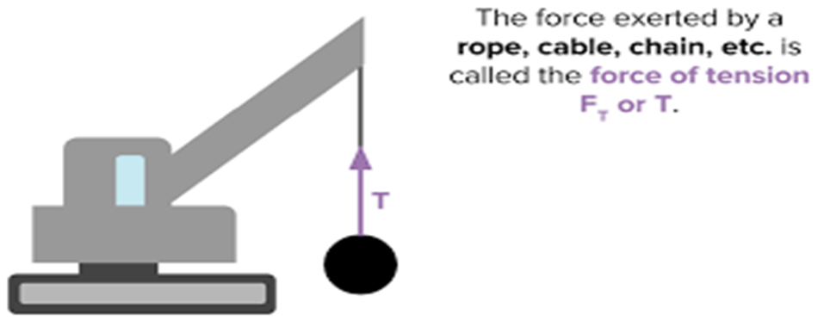
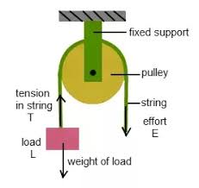
Examples:
Pulling on a rope in a tug of war game.
A car towing another car with the help of a chain.
Pulling a rope on a well which is connected to a pulley.

Slide 4
Representation:
We call this a tension force, represented by the symbol T. Tension is always directed along the line of the rope or string, with no component perpendicular to it. The SI unit of the tension is Newton (N).

Slide 5
How do we it calcualted?
There is no special formula to find the tension. The strategy employed to find the force is same as the one we use to find the normal force. Normally we use Newton’s second law.
Draw the forces exerted on the object in the equation.
Write the newton’s second law for a direction in which the tension is directed.
Solve for the tension using the Newton’s second law equation.
$a$=$\sum{F/m}$

Slide 6
Cont…
The tension on a body can be expressed numerically as:
T = mg + ma
Where :
T indicates tension in newton.
m indicates the mass in kg.
g indicates the gravitational force, 9.8 m/s².
a indicates the acceleration in m/s².

Slide 7
Example no 1:
Two masses 24kg and 26kg are attached to the ends of the string wire which passes over the frictionless pulley. 26kg is lying over a smooth horizontal table. 24kg mass is moving vertically downward. Find the tension and the acceleration in the bodies.

Slide 8
Cont..
Given data:
Mass of the block moving vertically= m1 = 24kg
Mass of the block moving along the table=m2= 26kg
Gravitational acceleration= g= 10 m/s2
Required:
Acceleration in the bodies = a = ?
Tension in the string= T=?

Slide 9
Cont…
Solution:
When one body is moving vertically and other is horizontally then acceleration of the bodies: a= m₁g/ m₁+ m₂
By putting the values in equation:
a= 24×10/ 24+ 26
a= 4.8 m/s²

Slide 10
Cont….
When the two bodies are moving vertically then tension in a string is:
T= m1 m2 g/ m1 + m2
By putting the value in above equation:
T= 24× 26 × 10/ 24 + 26
T= 124.8 N

